Slide 1

ITA0602 – MACHINE LEARNING
Technical presentation
Presented by
K Subrahmanyam (192312521)

Slide 2
Feature Selection in Machine Learning
Feature selection is the process of selecting the most relevant features from a dataset before training a machine learning model.
Importance
Improves prediction accuracy.
Removes irrelevant and redundant features.
Reduces overfitting.
Decreases training time.
Reduces computational complexity.
Improves model interpretability and generalization.

Slide 3
Feature Selection Techniques & PCA
Filter Methods
Uses statistical techniques (Correlation, Chi-Square).
Fast and suitable for large datasets.
Wrapper Methods
Evaluates different feature subsets using ML models.
More accurate but computationally expensive.
Embedded Methods
Performs feature selection during model training.
Examples: Decision Tree, Random Forest, LASSO.
Principal Component Analysis (PCA)
Reduces dimensionality.
Removes redundancy.
Improves efficiency and model performance.

Slide 4
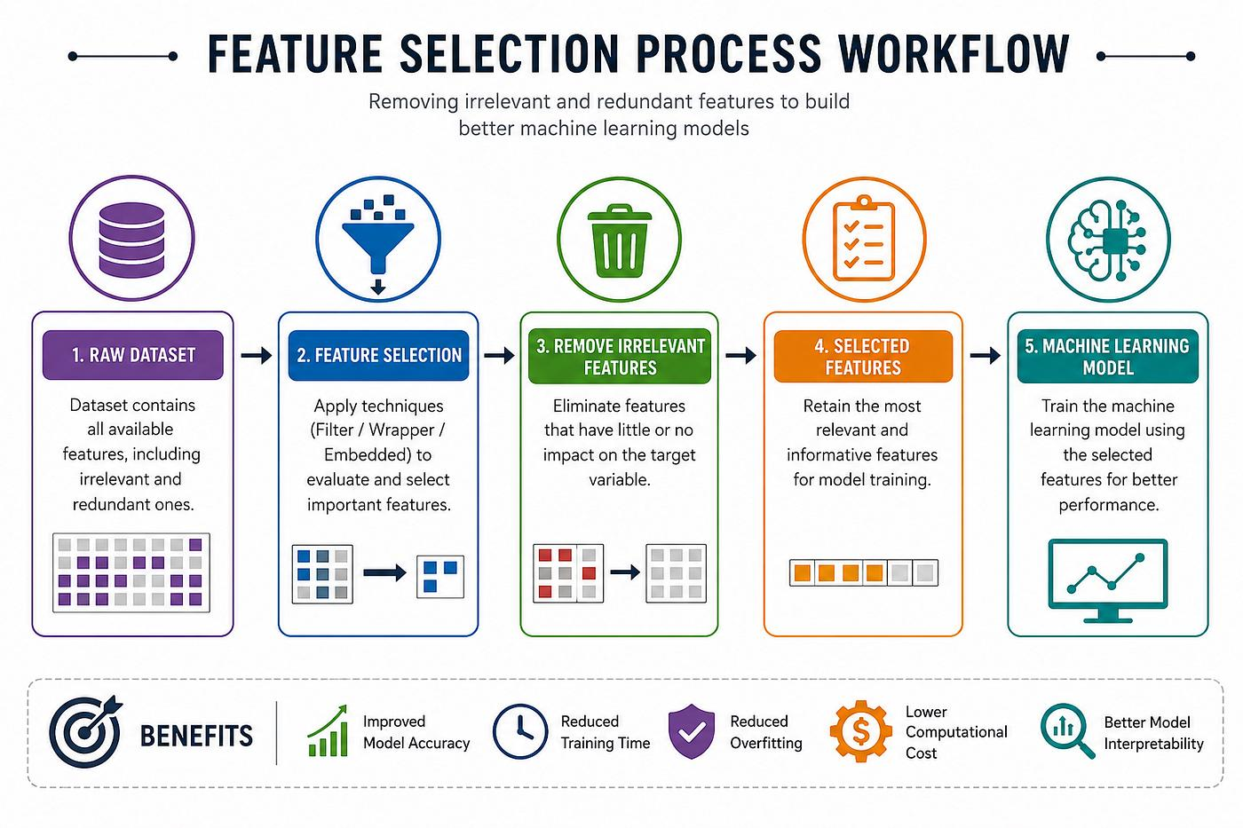

Slide 5
Model Evaluation Methods
Model evaluation determines how well a machine learning model performs on unseen data.
Techniques
Train-Test Split: Divides data into training and testing sets.
Cross Validation: Uses K-folds for reliable evaluation.
Bootstrapping: Random sampling with replacement for small datasets.
Provides unbiased performance estimation.
Helps compare different models effectively.

Slide 6
Performance Metrics & Validation
Classification Metrics
Accuracy
Precision
Recall
F1-Score
Confusion Matrix
ROC Curve
Regression Metrics
MAE
MSE
RMSE
R² Score

Slide 7
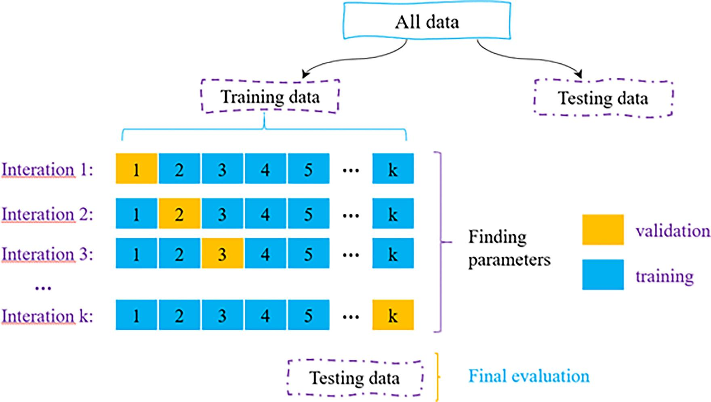

Slide 8
Performance Analysis
Performance analysis evaluates how effectively a machine learning model performs using quantitative metrics.
Performance Metrics
Accuracy
Precision
Recall
F1-Score
Sensitivity
Error Rate
Higher accuracy and lower error rates indicate better system performance.

Slide 9
Metric | Existing | Proposed
Accuracy | 88% | 95%
Precision | 86% | 94%
Recall | 84% | 93%
Error Rate | 12% | 5%
Merits
Improved accuracy.
Lower error rate.
Better scalability.
Faster processing.
Reliable performance.

Slide 10
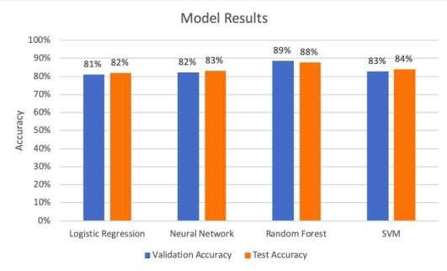

Slide 11
Future Scope
Machine learning systems continue to evolve with advancements in AI and data processing.
Future Enhancements
Use larger and more diverse datasets.
Integrate real-time data processing.
Apply Deep Learning techniques.
Develop hybrid and ensemble models.
Deploy on cloud and edge computing.
Improve explainability using Explainable AI (XAI).

Slide 12
Publication Potential
Research work can be converted into a journal or conference paper using a structured format.
Research Paper Structure
Abstract
Introduction
Literature Review
Methodology
Results & Discussion
Conclusion
References
Benefits
Academic recognition.
Knowledge sharing.
Supports future research.

Slide 13


Slide 14
Types of Learning Problems
Machine learning algorithms learn from data in different ways depending on the problem.
Types
Supervised Learning: Uses labeled data for prediction.
Unsupervised Learning: Finds hidden patterns in unlabeled data.
Reinforcement Learning: Learns through rewards and penalties.
Each approach is suitable for different real-world applications.

Slide 15
Learning Perspectives & Challenges
Learning Perspectives
Symbolic Approach: Uses logical rules and knowledge representation.
Statistical Approach: Uses probability and data-driven models.
Challenges
Poor data quality.
Overfitting and underfitting.
Computational complexity.
Scalability.
Feature selection and preprocessing.

Slide 16
